Slide 1
Brownian bridge
ICEF
Andriianchenko Alexander
Oktober 24’

Slide 2
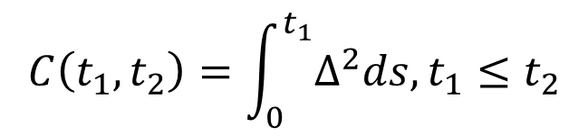
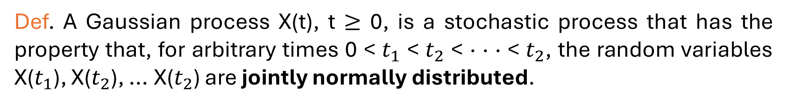
Gaussian Process
Def. A Gaussian process X(t), t $≥$ 0, is a stochastic process that has the property that, for arbitrary times 0 < $t_{1}$ < $t_{2}$ < · · · < $t_{2}$, the random variables X($t_{1}$), X($t_{2}$), ... X($t_{2}$) are jointly normally distributed.
$I\left(t\right)= \int_{0}^{t}{∆^{2}dW\left(s\right),∆ −non random}$
Proof: Shreve
$$C\left(t_{1},t_{2}\right)=\int_{0}^{t_{1}}{∆^{2}ds, t_{1}≤t_{2}}$$
Proof: on the board

Slide 3
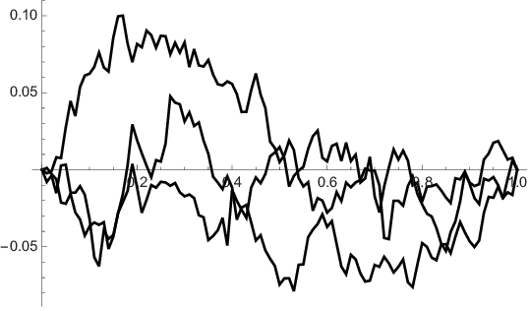
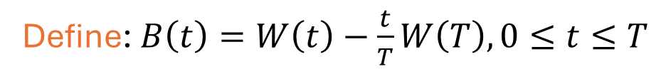
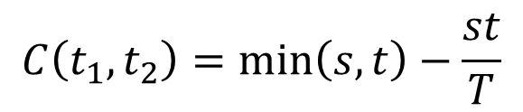

Brownian Bridge
Define: $B\left(t\right)=W\left(t\right)−\frac{t}{T}W\left(T\right), 0≤t≤T$
$$m\left(t\right)=0$$
$$C\left(t_{1},t_{2}\right)=\min\left(s,t\right)−\frac{st}{T}$$

Slide 4
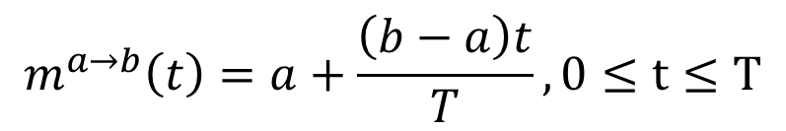
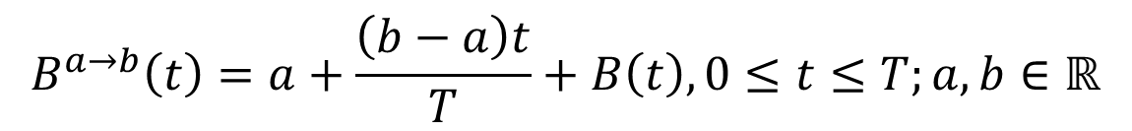
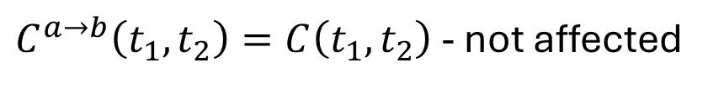
Brownian Bridge
Define: Brownian bridge from a to b on [0, T]
$$B^{a→b}\left(t\right)=a+\frac{\left(b−a\right)t}{T}+B\left(t\right), 0≤t≤T;a,b∈ℝ$$
$$m^{a→b}\left(t\right)=a+\frac{\left(b−a\right)t}{T}, 0≤t≤T$$
$C^{a→b}\left(t_{1},t_{2}\right)=C\left(t_{1},t_{2}\right)$ - not affected

Slide 5
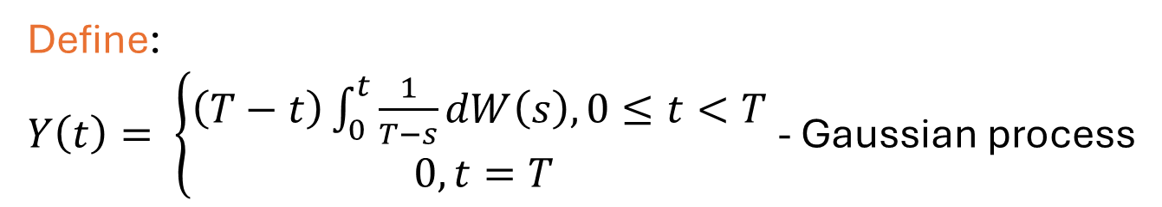
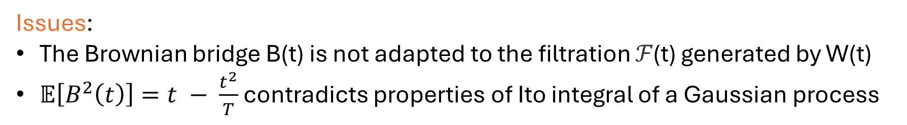
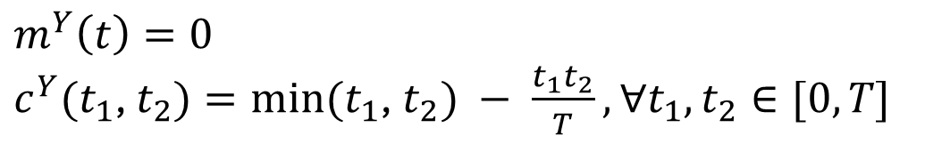
Brownian bridge as a stochastic integral
Issues:
The Brownian bridge B(t) is not adapted to the filtration ℱ(t) generated by W(t)
$𝔼\left[B^{2}\left(t\right)\right]=t − \frac{t^{2}}{T}$ contradicts properties of Ito integral of a Gaussian process
Define:
$Y\left(t\right)= \left\{\begin{aligned}\left(T−t\right)\int_{0}^{t}{\frac{1}{T−s}dW\left(s\right), 0≤t<T } \\ 0, t=T\end{aligned}\right.$- Gaussian process
Proof: on the board, pdf of Brownian bridge and Kolmogorov second equation
$$m^{Y}\left(t\right)=0$$
$c^{Y}(t_{1}$, $t_{2})=min⁡(t_{1}$, $t_{2}) − \frac{t_{1}t_{2}}{T}, ∀t_{1},t_{2}∈[0, T]$

Slide 6
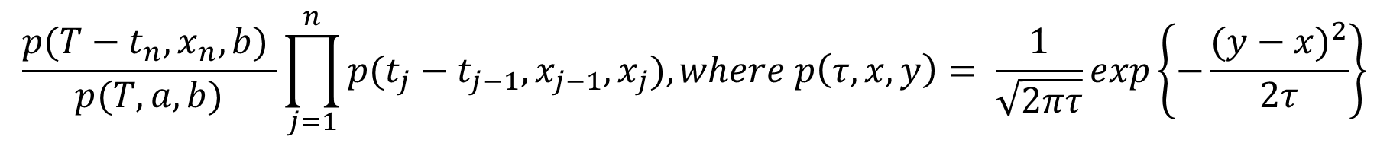
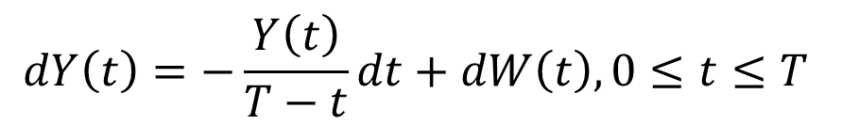
Brownian bridge as a stochastic integral
$$dY\left(t\right)=−\frac{Y\left(t\right)}{T−t}dt+dW\left(t\right), 0≤t≤T$$
Transition density of a Brownian bridge from 0 to 0
$$\frac{p(T−t_{n},x_{n},b) }{p(T,a, b)}\prod_{j=1}^{n}{p(t_{j}−t_{j−1},}x_{j−1},x_{j}), where p\left(τ, x, y\right)= \frac{1}{\sqrt{2πτ}}exp\left\{−\frac{{(y−x)}^{2}}{2τ}\right\}$$
Proof: Shreve

Slide 7
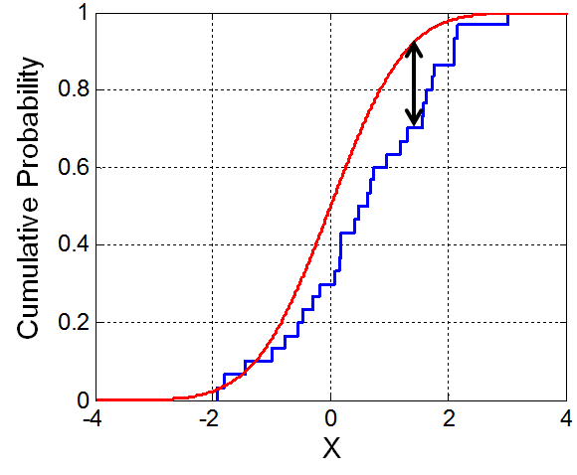
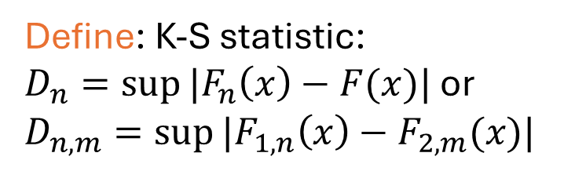
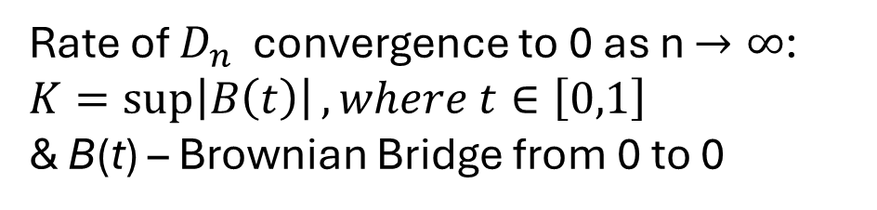
Kolmogorov-Smirnov test
Gist: Non-parametric of the equality of one-dimensional distributions
Define: K-S statistic:
$D_{n}=sup⁡|F_{n}\left(x\right)−F(x)|$ or $D_{n,m}=sup⁡|F_{1,n}\left(x\right)−F_{2,m}(x)|$
Rate of $D_{n}$ convergence to 0 as n $→∞$:
$K=\sup\left|B\left(t\right)\right|, where t∈\left[0,1\right]$
& B(t) – Brownian Bridge from 0 to 0
Proof: Kolmogorov, 1933

Slide 8
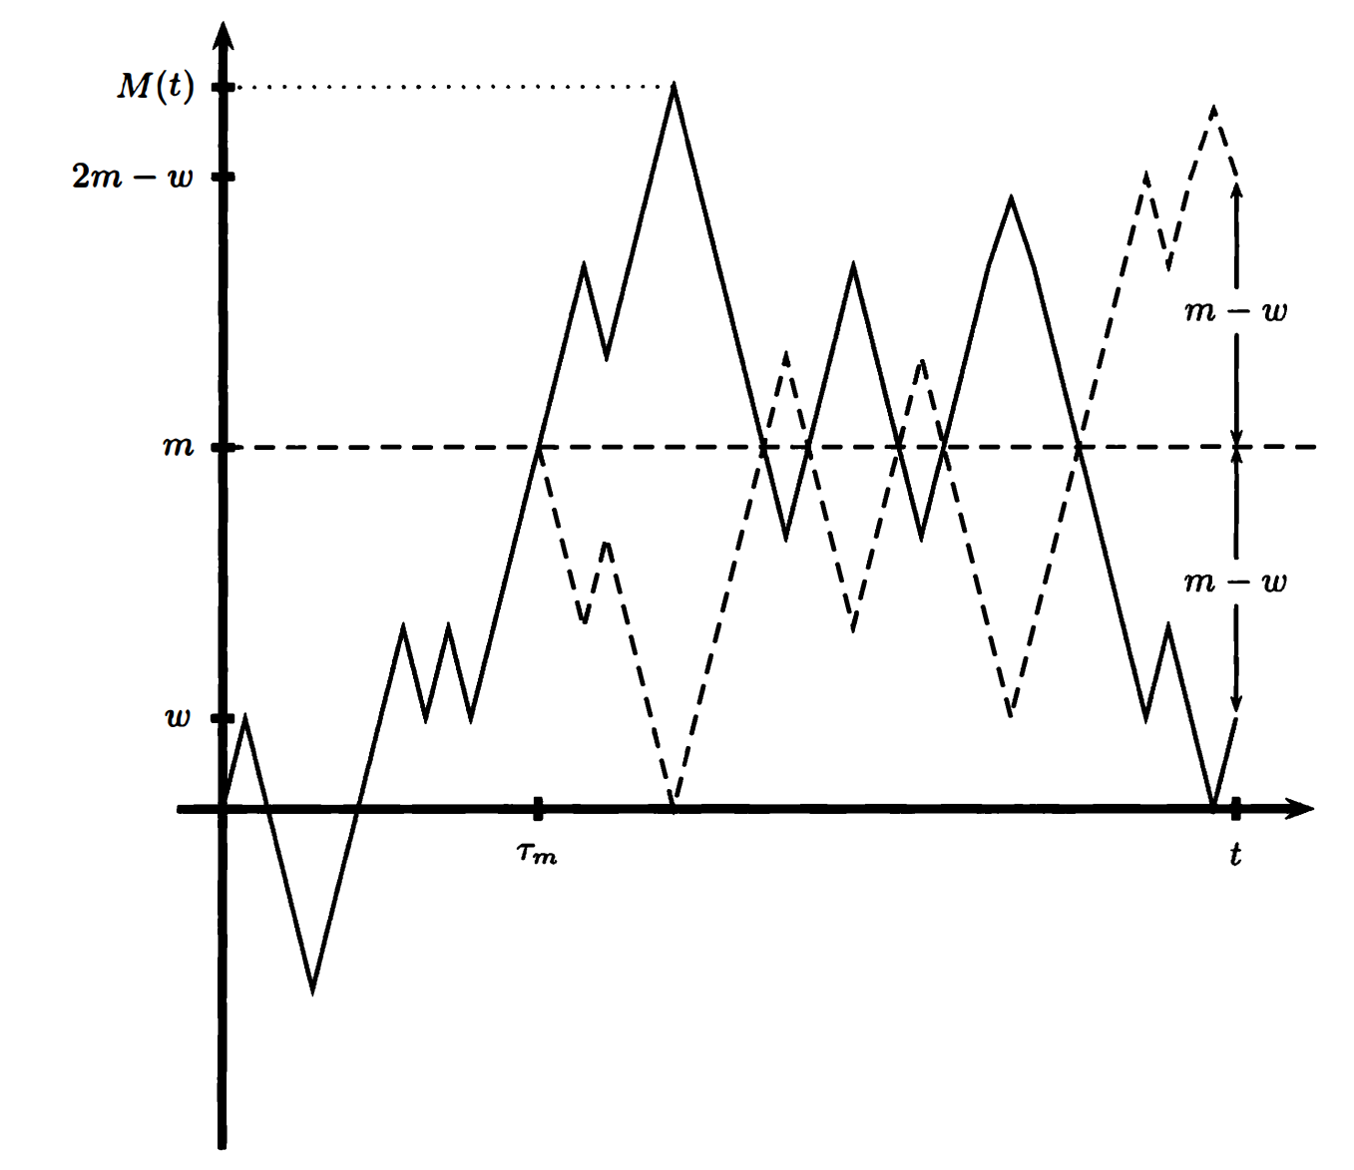
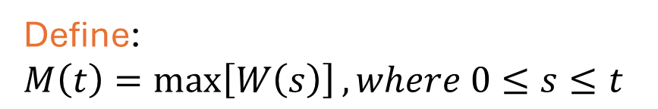
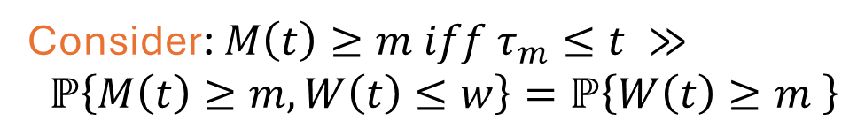
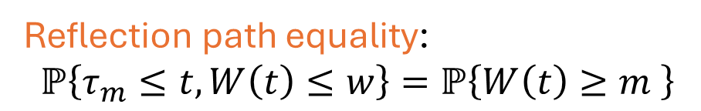
Maximum value of a Brownian Motion
Define:
$$M\left(t\right)=\max\left[W\left(s\right)\right], where 0≤s≤t$$
Reflection path equality:
$$ℙ\left\{τ_{m}≤t, W\left(t\right)≤w\right\}=ℙ\left\{W\left(t\right)≥m \right\}$$
Consider: $M\left(t\right)≥m iff τ_{m}≤t ≫$
$$ℙ\left\{M\left(t\right)≥m, W\left(t\right)≤w\right\}=ℙ\left\{W\left(t\right)≥m \right\}$$

Slide 9
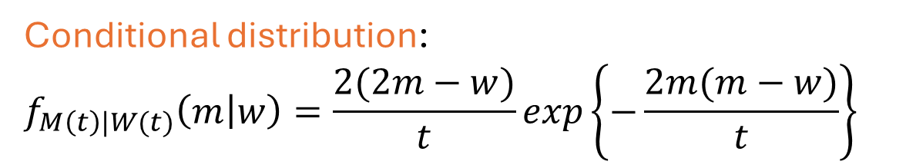
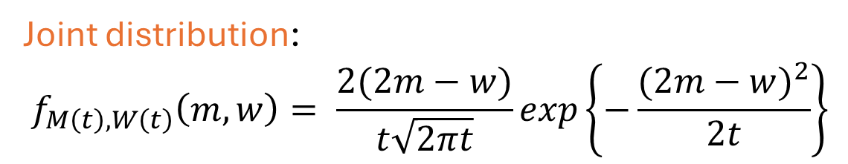
Maximum value of a Brownian Motion
Joint distribution:
$$f_{M\left(t\right), W\left(t\right)}\left(m,w\right)= \frac{2(2m−w)}{t\sqrt{2πt}}exp\left\{−\frac{{(2m−w)}^{2}}{2t}\right\}$$
Proof: on the board
Conditional distribution:
$$f_{M\left(t\right)|W(t)}\left(m | w\right)=\frac{2(2m−w)}{t}exp\left\{−\frac{2m(m−w)}{t}\right\}$$
Proof: on the board

Slide 10
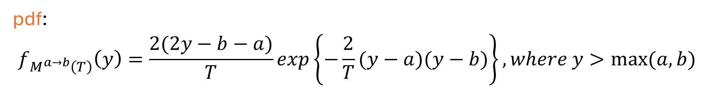
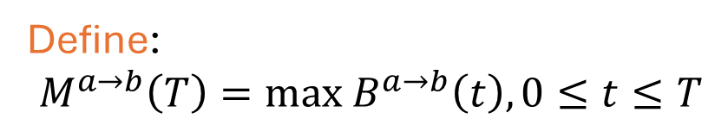
Maximum value of a Brownian Bridge
Define:
$$M^{a→b}\left(T\right)=max{ B}^{a→b}\left(t\right), 0≤t≤T$$
pdf:
$$f_{M^{a→b}\left(T\right)}\left(y\right)=\frac{2(2y−b−a)}{T}exp\left\{−\frac{2}{T}(y−a)(y−b)\right\}, where y>max⁡(a,b)$$
Proof: on the board, start point and end point condition

Slide 11
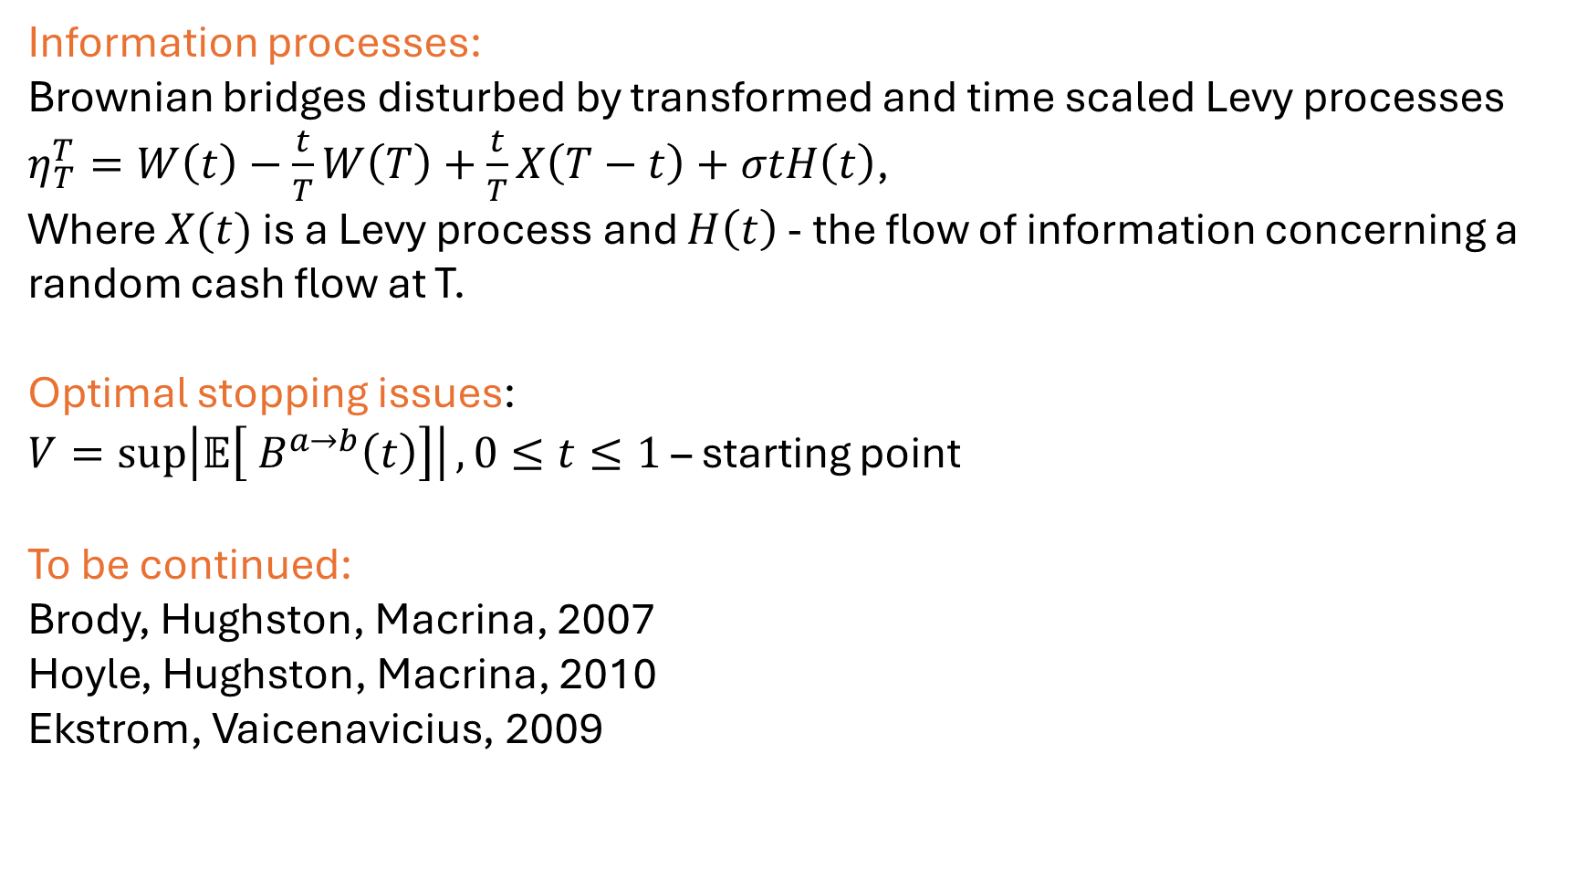
Other applications
Information processes:
Brownian bridges disturbed by transformed and time scaled Levy processes
$η_{T}^{T}=W\left(t\right)−\frac{t}{T}W\left(T\right)+\frac{t}{T}X\left(T−t\right)+σtH\left(t\right)$,
Where $X(t)$ is a Levy process and $H\left(t\right)$ - the flow of information concerning a random cash flow at T.
Optimal stopping issues:
$V=\sup\left|𝔼\left[{ B}^{a→b}\left(t\right)\right]\right|, 0≤t≤1$– starting point
To be continued:
Brody, Hughston, Macrina, 2007
Hoyle, Hughston, Macrina, 2010
Ekstrom, Vaicenavicius, 2009

